Slide 1
TASK 2
NETSPARKER

Slide 2
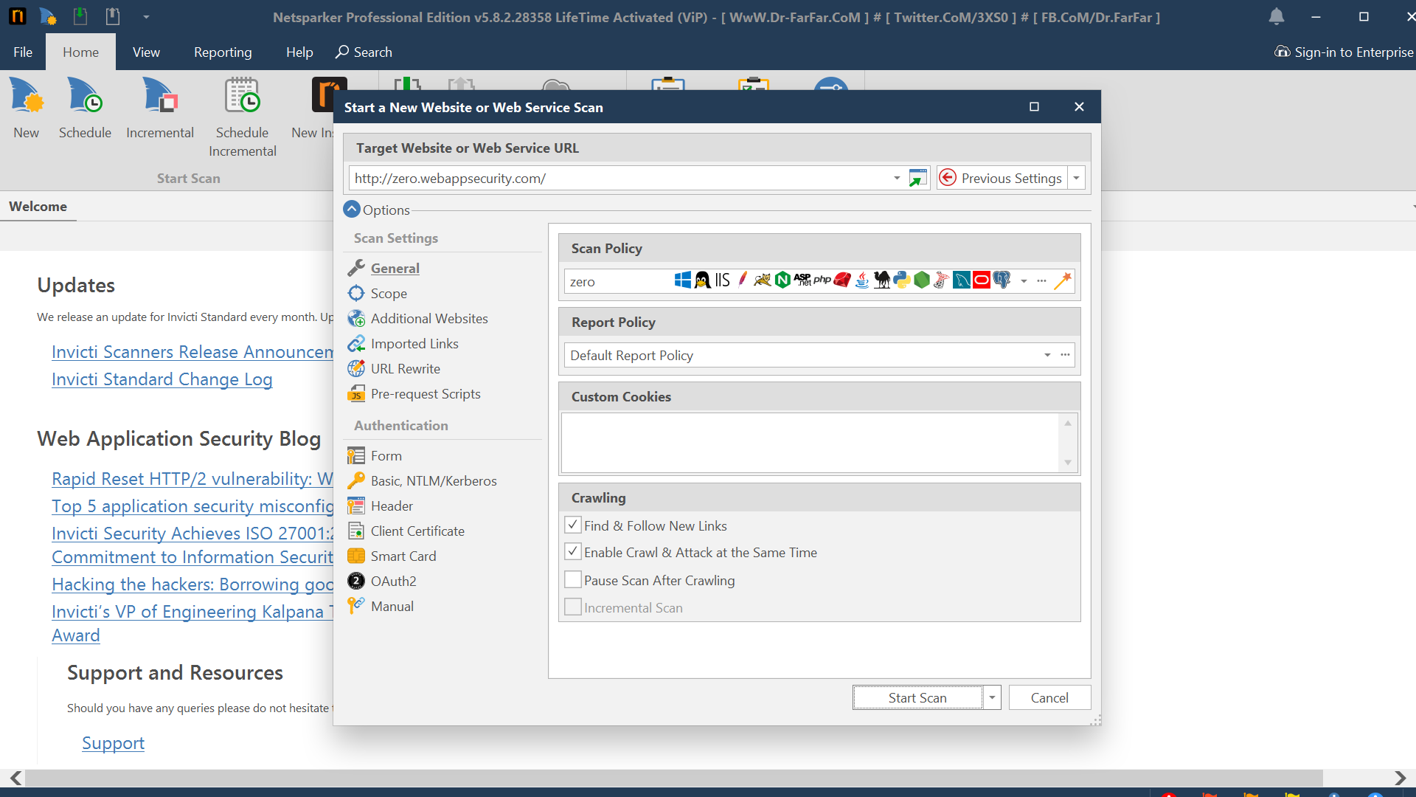

Slide 3
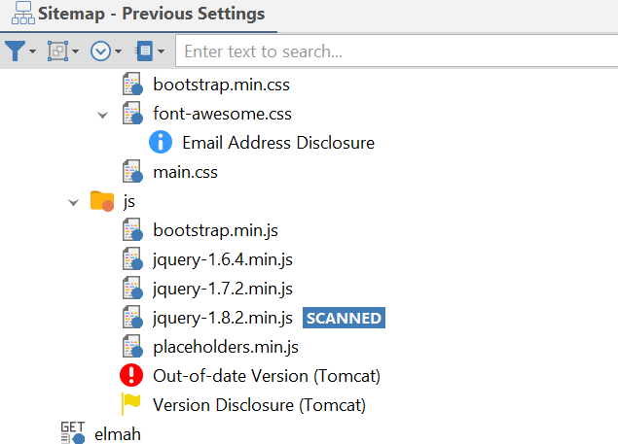
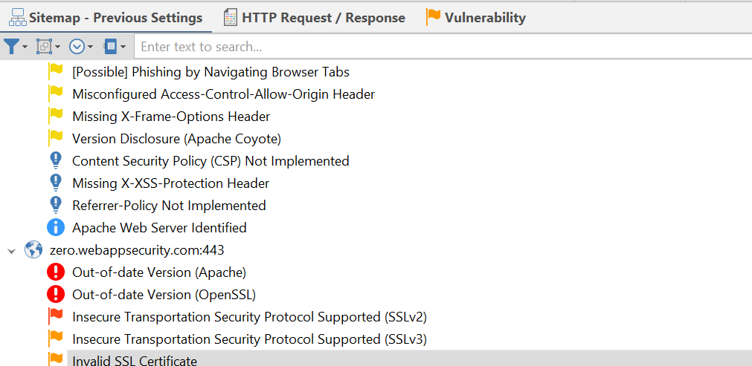

Slide 4
1. TITLE => OUT OF DATE VERSION (Tomcat)
Vulnerability(Issue):
The version used in this is very old and the older version contains more bugs compared to the latest version.
Impact:
As the software used in this is of an older version, it is more prone to the attacks. Any hacker can attack your website.
Mitigation:
The Apache can be upgraded to the latest version to avoid malicious attacks.
The identified version in this vulnerability is 7.0.70
It can be updated to the latest version which is 10.1.15
Mitigation references:
The updated version can be obtained from the below link: https://tomcat.apache.org/whichversion.html
Known Vulnerabilities in this Version:
Cross-Site Scripting

Slide 5
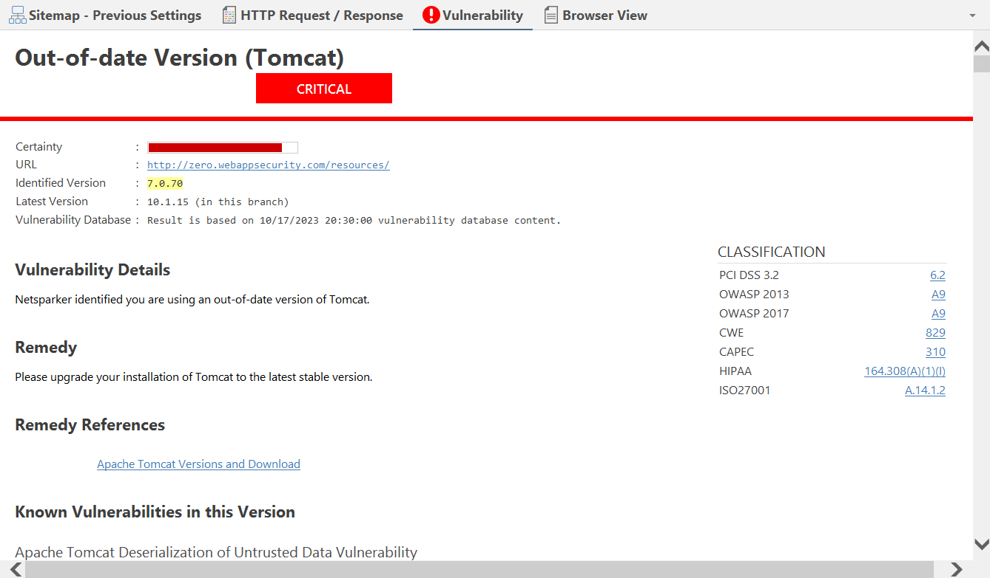

Slide 6
2. TITLE => OUT OF DATE VERSION (Apache)
Vulnerability(Issue):
The version used in this is very old and the older version contains more bugs compared to the latest version.
Impact:
As the software used in this is of an older version, it is more prone to the attacks. Any hacker can attack your website.
Mitigation:
The Apache can be upgraded to the latest version to avoid malicious attacks.
The identified version in this vulnerability is 2.2.6
It can be updated to the latest version which is 2.2.34
Mitigation references:
The updated version can be obtained from the below link: https://httpd.apache.org/download.cgi
Known Vulnerabilities in this Version:
Cross-Site Scripting

Slide 7
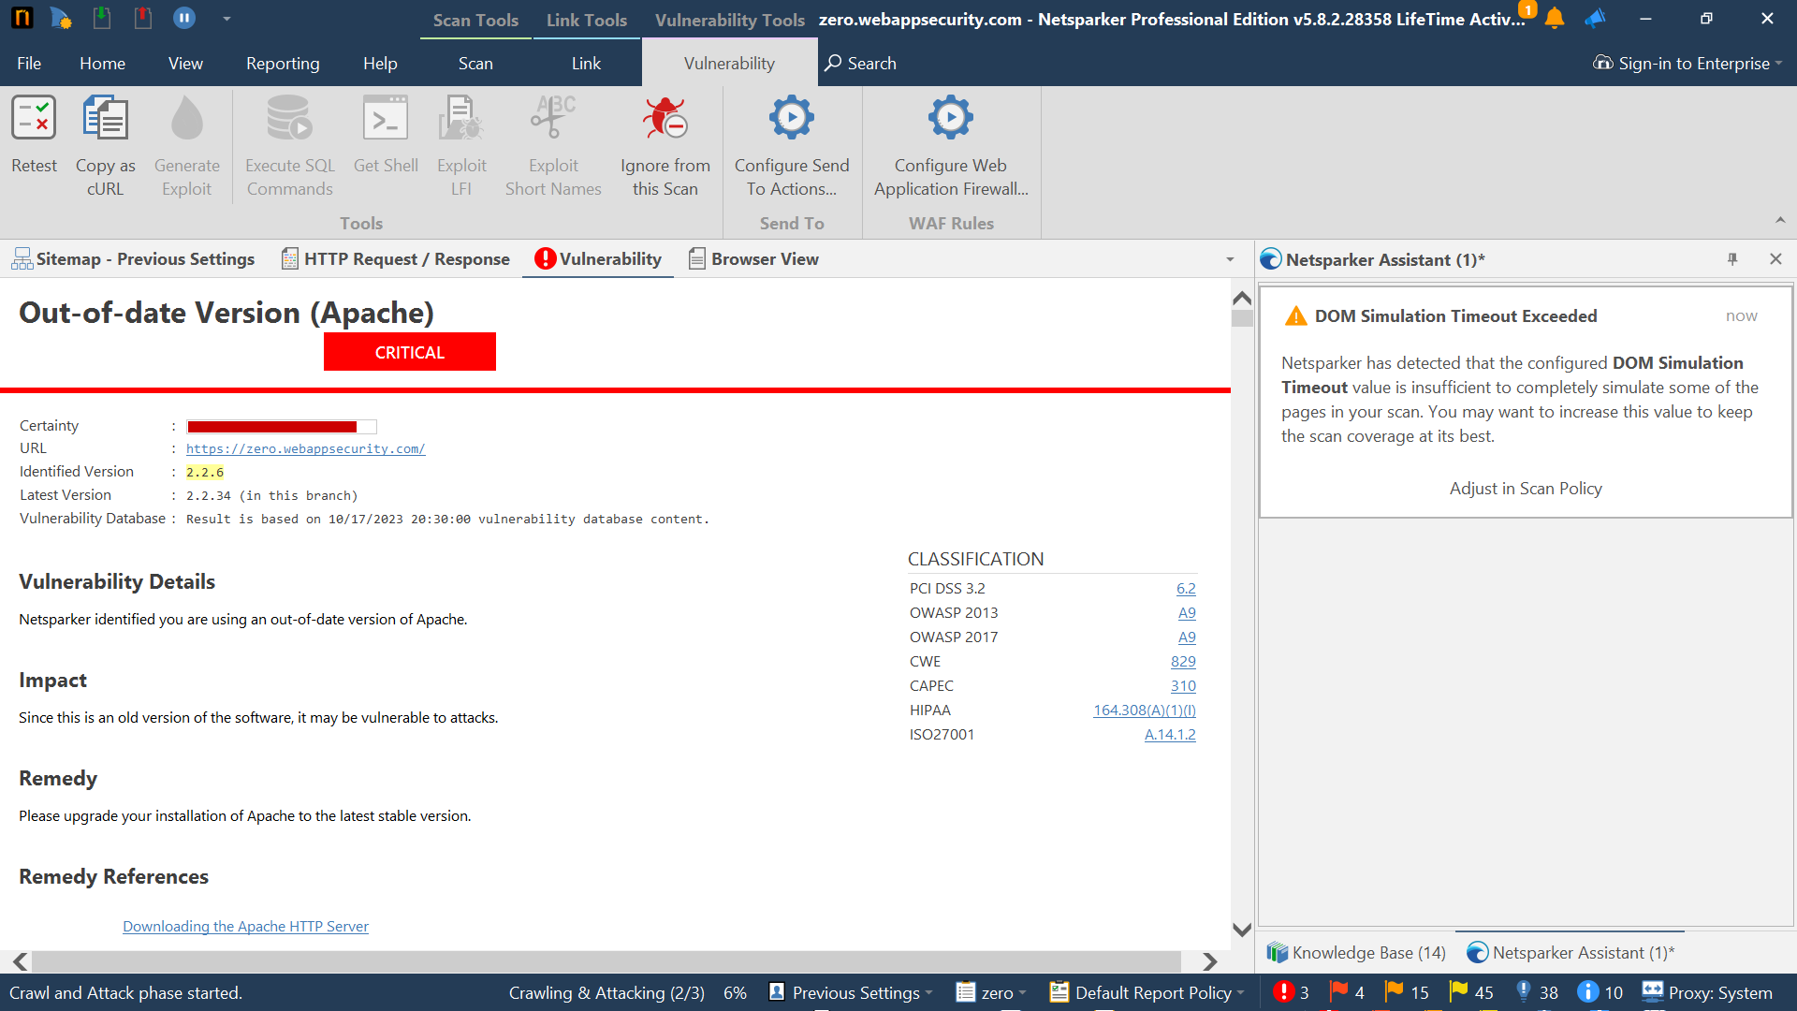

Slide 8
3. TITLE => OUT OF DATE VERSION (OpenSSL)
Vulnerability(Issue):
The version used in this is very old and the older version contains more bugs compared to the latest version.
Impact:
As the software used in this is of an older version, it is more prone to the attacks. Any hacker can attack your website.
Mitigation:
The OpenSSL can be upgraded to the latest version to avoid malicious attacks.
The identified version in this vulnerability is 0.9.8e
It can be updated to the latest version which is 3.1.3
Mitigation references:
The updated version can be obtained from the below link: https://www.openssl.org/
Known Vulnerabilities in this Version:
Cross-Site Scripting
Man In The Middle Attack

Slide 9
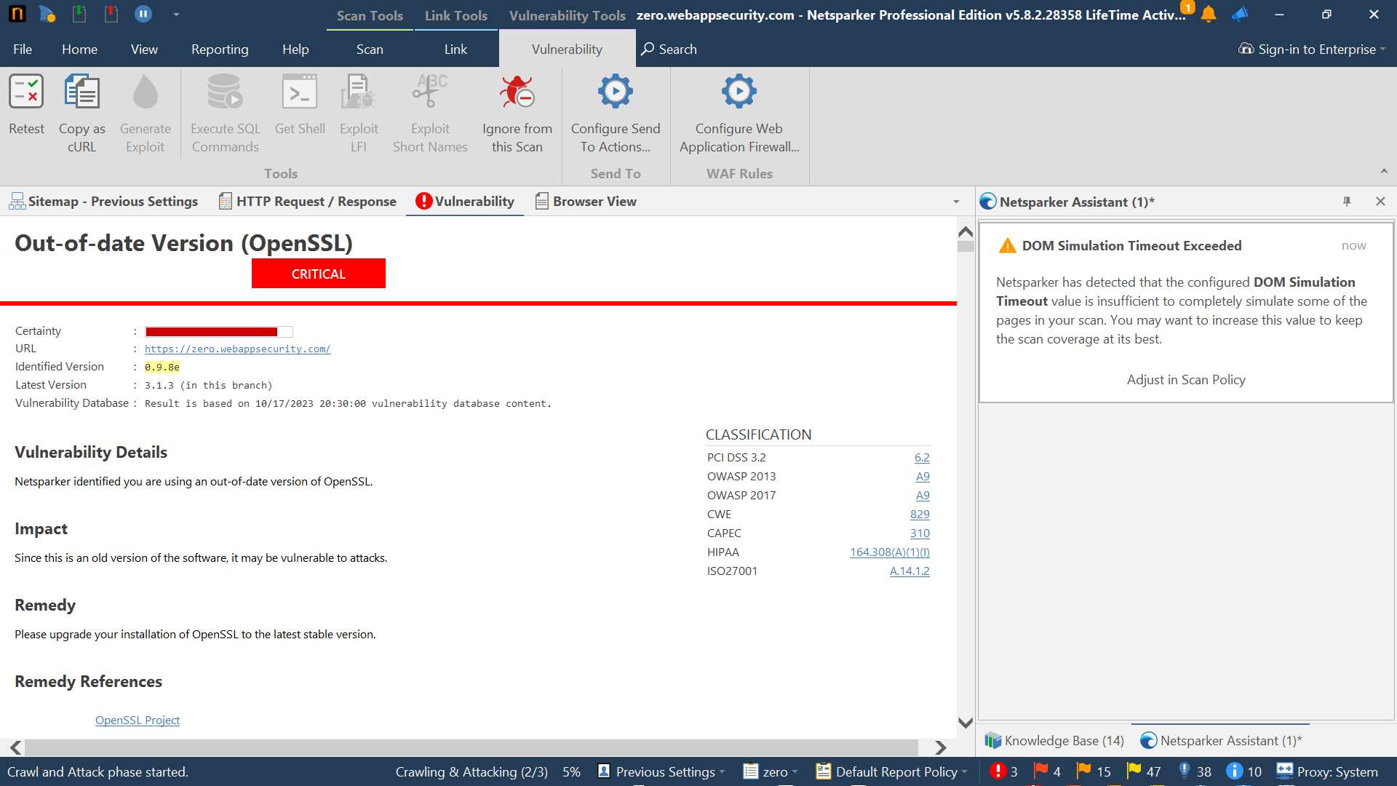

Slide 10
THANK YOU

